Slide 1
Linux Fundamental
Course Code: GCS-I105
By : Cuong Do
Date : Jun 21, 2005
Duration: 6 hours
Revision: 1.0
Notes:
NOTES:
1. Overall
Duration:
One day course
Target:
Provide information and commands to user for working on linux environment
Audience:
Software engineers who had knowledge about Operating System and use PC everyday.
2. Prepare for demos
linux machine
putty
winscp
exceed
scripts

Slide 2
Table of Contents
Getting started
File system
vi editor
Shell basics
Process control
Shell programming
System administration basics
GUI basics
Notes:
NOTES:
Table of contents
1. Getting started
Linux features
Login, Logout
User, Group
Shell
Home directory
Manual page
2. File system
Common directories
File system hierarchy
File type
File permission and Access
3. vi editor
Command mode
Input mode
Ex mode
4. Shell basics
Shell definition
Shell type
Shell characteristic
Shell variables
File name generation
Quoting
Input output redirection
Regular expression
5. Process control
Process monitoring
Job control
6. Shell programming
Support syntax
Signals
7. System administration
Boot level
Scheduled tasks
8. GUI
X windows
X terminal

Slide 3
Getting started
1: Getting started
Notes:
NOTES:
Linux features
Login, Logout
User, Group
Shell
Home directory
Manual page

Slide 4
1-1 Linux features
Multi users system
User interact with system through shell
Support a lot of commands, utilities
Use pipelines to create complex commands
Notes:
NOTES:
1. Some tools and applications
Electronic mail (mail)
File editing (ed, ex, vi)
Text processing (sort, grep, wc, awk, sed)
Text formatting (nroff)
Program development (gcc, g++, make)
Process and user accounting (ps, du)
2. Sample for combined commands:
Kill specific process
#ps –ef|grep httpd|awk ‘{print $2}’ |xargs –l kill -9
Change specific text in files
#find /projects/src –name ‘*.java’| while read file; do cat $file|sed –e ‘s/System\.out\.print/System\.out\.println/g’ > __tmp__; mv __tmp__ $file; done

Slide 5
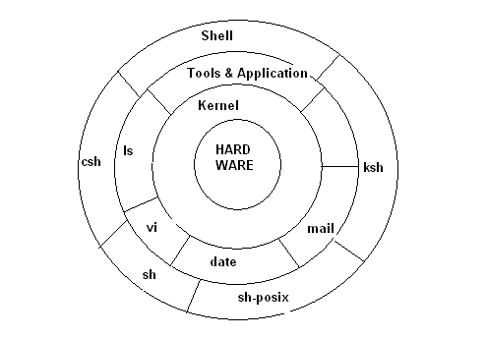
1-2 Linux features
Notes:
NOTES:
Shell is interactive command interpreter. Commands are entered at the shell prompt. A user communicates with the computer through the shell. The shell gathers the input and translate the command into a form the kernel can understand. Then the system will execute the command.
There are following shell type:
Bourne shell: (usr/old/bin/sh)
C shell (/usr/bin/csh)
Korn shell (/usr/bin/ksh)
POSIX shell (/usr/bin/sh)
C shell with filename completion and command line editing (/usr/bin/tcsh)
GNU Bourne Again Shell (/usr/bin/bash)

Slide 6
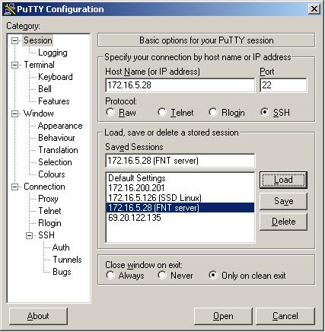
1-2 Login
Login by telnet - ssh
Notes:
NOTES:
Telnet (port 23) is closed by default for security reason.
ssh (port 22) which provides secure communication is used.

Slide 7
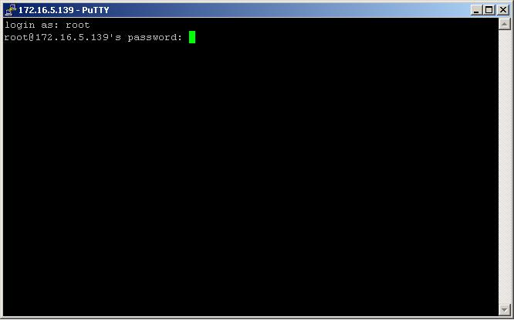
1-4 Login
Login screen
Notes:
NOTES:
1. User input user name and password to login
2. To logout, we can type exit, or press Ctrl-d or close the terminal program
3. Some simple commands
id - print real and effective UIDs and GIDs
who - show who is logged on
whoami – show currently used account
date - print or set the system date and time
passwd – update user password
echo - display a line of text
clear - clear the terminal screen

Slide 8
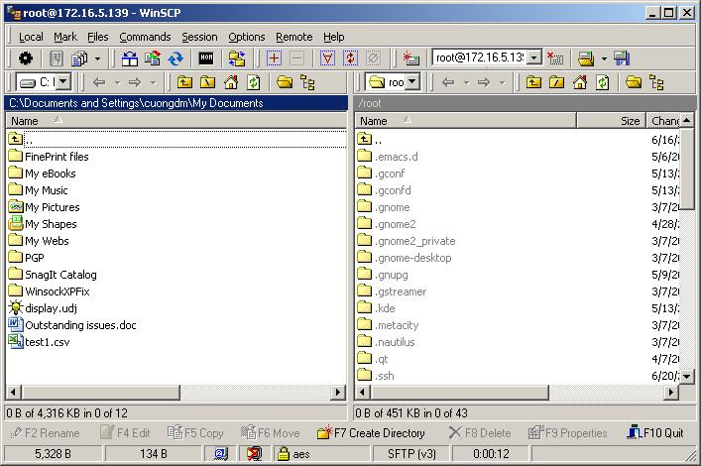
1-5 File transfer
sftp – file transfer over ssh
Notes:
NOTES:
SFTP: FTP over SSH. The commands is similar to FTP
WinSCP: tool for file transfer over SSH using FTP (http://winscp.net/eng/index.php)

Slide 9

1-6 User - Group
User is identified by user name and user id
  /etc/passwd
User can belongs to one or many group
  /etc/group
Add new user
Add new group
Notes:
NOTES:
/etc/passwd contains user information
Format of /etc/passwd
account:password:UID:GID:GECOS:directory:shell
Description for each field:
account
the name of the user on the system. It should not contain capital letters.
password
the encrypted user password or a star.
UID
the numerical user ID.
GID
the numerical primary group ID for this user.
GECOS
This field is optional and only used for informational purposes. Usually, it con- tains the full user name. GECOS means General Electric Comprehensive Operating System, which has been renamed to GCOS when GE's large systems division was sold to Honeywell. Dennis Ritchie has reported: "Sometimes we sent printer out- put or batch jobs to the GCOS machine. The gcos field in the password file was a place to stash the information for the $IDENTcard. Not elegant."
directory
the user's $HOME directory.
shell
the program to run at login (if empty, use /bin/sh). If set to a non-existing executable, the user will be unable to login through login(1).

Slide 10
1-7 Shell
Shell is command interpreter
Shell level
  echo $SHLVL
Notes:
NOTES:
Shell basic functions:
Command line interpretation
Program initialization
Input-output redirection
Pipeline connection
Substitution of filename
Maintenance of variables
Environment control
Shell programming

Slide 11
1-8 Home directory
/home/<username>
/root
Home directory is specified in /etc/passwd (field number 6)
Notes:
NOTES:

Slide 12
1-9 Manual page
Online manual page
  man date
    Display manual of command date
  man –k copy
    Display entries with keyword copy
Notes:
NOTES:
Content of the man page:
NAME
This lists the exact name of the command(s) covered by this manual page and gives a short description of what the command does.
SYNOPSIS
This section gives a summary of command usage. It enables you to see how options can be given to the command. For example:
cp [-iprR] directory1 directory2 The first word or consecutive characters are the name of the command.
The characters enclosed in [square brackets] are optional. A '-' (hyphen) preceding a character indicates that this is an option that can be applied to the command.
Options grouped together after a single hyphen, like this, [-abcD] can be used in this format. If they are given separately, like this, [-n] [-r] [-Z] then they must be used in this format.
Arguments are represented by a name such as file, filename or directory.
DESCRIPTION
This section gives a detailed description of how the command works. For some commands this section consists of a few lines; for others it can be several pages long.
OPTIONS
This section explains the action that each option has when used with the command.
ENVIRONMENT
This section gives the names of any environment variables used by the command and the value(s) that they can be set to.
EXAMPLES
This section provides you with examples of how the command can be used. It is often omitted.
FILES
This section gives details of the files used by the command.
SEE ALSO
This section refers you to the manual page for commands that contain related information. Follow these references to learn which commands are associated with each other.
WARNINGS
This section warns you against using the command in a way that might cause you problems.
DIAGNOSTICS
This section explains the meaning of the various diagnostic messages that the command may present you with. Messages that are considered self explanatory are not included.
BUGS
This section advises you about known 'bugs' or shortcomings with the command.

Slide 13
1-10 Manual page – How to
Man page section
  man exports (5) /etc/exports
  man fstab (5) /etc/fstab
  man mount (8)
  man umount (8)
  man printf (2)
  man syslog (3)
How to
  Support information from internet
Notes:
NOTES:
Man page sections:
1 User commands that may be started by everyone.
2 System calls, that is, functions provided by the kernel.
3 Subroutines, that is, library functions.
4 Devices, that is, special files in the /dev directory.
5 File format descriptions, e.g. /etc/passwd.
6 Games, self-explanatory.
7 Miscellaneous, e.g. macro packages, conventions.
8 System administration tools that only root can execute.
9 Another (Linux specific) place for kernel routine documentation.

Slide 14
File system
2: File system
Notes:
NOTES:
Common directories
File system hierarchy
File type
File permission and Access

Slide 15
2-1 Common directories
Home directory
  /home/user
  /root
/usr
  /usr/bin
  /usr/sbin
  /usr/lib
  /usr/local
/etc
Notes:
NOTES:
/bin
Essential command binaries
/boot
Static files of the boot loader
/dev
Device files
/etc
Host-specific system configuration
/lib
Essential shared libraries and kernel modules
/media
Mount point for removable media
/mnt
Mount point for mounting a file system temporarily
/opt
Add-on application software packages
/sbin
Essential system binaries
/srv
Data for services provided by this system
/tmp
Temporary files
/usr
Secondary hierarchy
/var
Variable data

Slide 16
2-2 Common directories
/tmp
/mnt
/proc
  /proc/cpuinfo
  /proc/meminfo
/var
  /var/log
Notes:
NOTES:
/bin
Essential command binaries
/boot
Static files of the boot loader
/dev
Device files
/etc
Host-specific system configuration
/lib
Essential shared libraries and kernel modules
/media
Mount point for removeable media
/mnt
Mount point for mounting a filesystem temporarily
/opt
Add-on application software packages
/sbin
Essential system binaries
/srv
Data for services provided by this system
/tmp
Temporary files
/usr
Secondary hierarchy
/var
Variable data

Slide 17
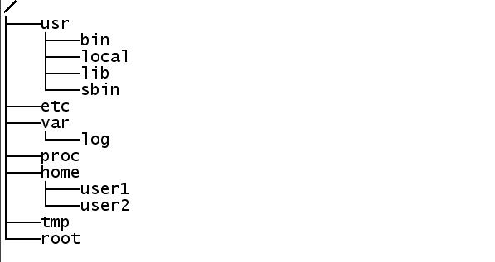
2-3 File system hierarchy
Notes:
NOTES:

Slide 18
2-4 File type
Regular files
  Text file
  Executable files
Directory
  Directory
  Mounting point
Device file
  Special file provide interface to device
Link file
  Hard link
  Symbolic link
Notes:
NOTES:

Slide 19
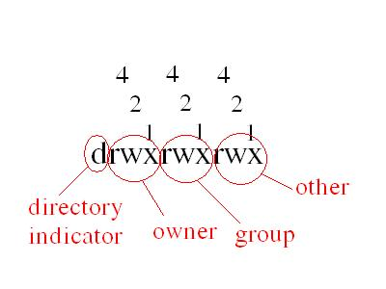
2-5 File permission and access
chmod
chown
chgrp
Notes:
NOTES:

Slide 20
2-6 File permission and access
Read
  Files: contents can be examined (cat, more, vi)
  Directories: content can be examined (ls)
Write
  Files: contents can be changed (vi)
  Directories: contents can be changed (mv, mkdir, cp, rmdir, rm)
Execute
  Files: file can be used as a command
  Directories: can become current working directory
Notes:
NOTES:

Slide 21
vi editor
3: vi editor

Slide 22
3-1 vi editor
Command mode
  Commands for navigation, copy, paste
Edit mode
  Input, edit text
ex
  Utility Commands
  Can call shell command in vi
Notes:
NOTES:

Slide 23
3-2 invoke vi
Invoke vi
  vi filename
Default mode
  default mode is command mode
  At edit or ex, user can press ESC to return to command mode
Quit vi
  ZZ - quit and save file in command mode
  :q! - Quit and do not save file in ex mode
  :wq - Quit and save file in ex mode
vim
  new vi editor which is added more features
Notes:
NOTES:
1. Invoke vi
vi filename
If file existed, the current file is loaded to edit.
If file did not exist, vi edits new file.
2. vim (www.vim.org)

Slide 24
3-3 edit mode
From command mode to edit mode
  i - insert text at cursor
  a - append text after cursor
  o - open new line below cursor to edit text
  O - open new line above cursor to edit text
Notes:
NOTES:

Slide 25
3-4 command mode
Press ESC to return to command mode from edit or ex
Movement
  Use arrow key (not vi command)
  h - right
  j - up
  k - down
  l - left
  Ctrl b - back one page
  Ctrl d - down one page
Notes:
NOTES:
Basic vi commands.
Command Meaning
0 Move to beginning of line.
$ Move to end of line.
/pattern Search forward for the next line using a specified pattern.
?pattern Search backward for the next line using a specified pattern.
a Append text—move into insert mode after the current character.
^b Back up one screen of text.
B Back up one space-delimited word.
b Back up one word.
Backspace Move left one character.
http://docs.rinet.ru/UNIXy/unx07.htm (44 of 104) [4/27/1999 10:48:24 AM]
^d Move down half a page.
D Delete through end of line.
d Delete—dw = delete word, dd = delete line.
Esc Leave insert mode, return to command mode.
^f Move forward one screen of text.
G Go to the last line of the file.
nG Go to the nth line of the file.
h Move left one character.
i Insert text—move into insert mode before the current character.
j Move down one line.
k Move up one line.
l Move right one character.
n Repeat last search.
O Open new line for insert above the current line.
o Open new line for insert below the current line.
Return Move to beginning of next line.
^u Move up half a page.
U Undo—replace current line if changed.
u Undo the last change made to the file.
W Move forward one space-delimited word.
w Move forward one word.
x Delete a single character.
:e file Edit a specified file without leaving vi.
:n Move to the next file in the file list.
:q Quit vi and return to the UNIX prompt.
:q! Quit vi and return to the system, throwing away any changes made to the file.
:r file Read the contents of a specified file, including it in the current edit buffer.
:w file Write the contents of the buffer to a specified file.
:w Write the edit buffer to the system.

Slide 26
3-5 command mode
Information
  Ctrl g - file information
  10G - go to line 10 of edit file
  0 - Move to beginning of file
  $ - Move to end of file
  . - repeat last command
Use number as number of times to do command
  4k - Go down 4 lines
Notes:
NOTES:
Basic vi commands.
Command Meaning
0 Move to beginning of line.
$ Move to end of line.
/pattern Search forward for the next line using a specified pattern.
?pattern Search backward for the next line using a specified pattern.
a Append text—move into insert mode after the current character.
^b Back up one screen of text.
B Back up one space-delimited word.
b Back up one word.
Backspace Move left one character.
http://docs.rinet.ru/UNIXy/unx07.htm (44 of 104) [4/27/1999 10:48:24 AM]
^d Move down half a page.
D Delete through end of line.
d Delete—dw = delete word, dd = delete line.
Esc Leave insert mode, return to command mode.
^f Move forward one screen of text.
G Go to the last line of the file.
nG Go to the nth line of the file.
h Move left one character.
i Insert text—move into insert mode before the current character.
j Move down one line.
k Move up one line.
l Move right one character.
n Repeat last search.
O Open new line for insert above the current line.
o Open new line for insert below the current line.
Return Move to beginning of next line.
^u Move up half a page.
U Undo—replace current line if changed.
u Undo the last change made to the file.
W Move forward one space-delimited word.
w Move forward one word.
x Delete a single character.
:e file Edit a specified file without leaving vi.
:n Move to the next file in the file list.
:q Quit vi and return to the UNIX prompt.
:q! Quit vi and return to the system, throwing away any changes made to the file.
:r file Read the contents of a specified file, including it in the current edit buffer.
:w file Write the contents of the buffer to a specified file.
:w Write the edit buffer to the system.

Slide 27
3-6 command mode
Search
  / - Search forward
  ? – Search backward
  n – Continue search in forward direction
  N – Continue search in reverse direction
Notes:
NOTES:
Basic vi commands.
Command Meaning
0 Move to beginning of line.
$ Move to end of line.
/pattern Search forward for the next line using a specified pattern.
?pattern Search backward for the next line using a specified pattern.
a Append text—move into insert mode after the current character.
^b Back up one screen of text.
B Back up one space-delimited word.
b Back up one word.
Backspace Move left one character.
http://docs.rinet.ru/UNIXy/unx07.htm (44 of 104) [4/27/1999 10:48:24 AM]
^d Move down half a page.
D Delete through end of line.
d Delete—dw = delete word, dd = delete line.
Esc Leave insert mode, return to command mode.
^f Move forward one screen of text.
G Go to the last line of the file.
nG Go to the nth line of the file.
h Move left one character.
i Insert text—move into insert mode before the current character.
j Move down one line.
k Move up one line.
l Move right one character.
n Repeat last search.
O Open new line for insert above the current line.
o Open new line for insert below the current line.
Return Move to beginning of next line.
^u Move up half a page.
U Undo—replace current line if changed.
u Undo the last change made to the file.
W Move forward one space-delimited word.
w Move forward one word.
x Delete a single character.
:e file Edit a specified file without leaving vi.
:n Move to the next file in the file list.
:q Quit vi and return to the UNIX prompt.
:q! Quit vi and return to the system, throwing away any changes made to the file.
:r file Read the contents of a specified file, including it in the current edit buffer.
:w file Write the contents of the buffer to a specified file.
:w Write the edit buffer to the system.

Slide 28
3-7 ex mode
Press : to go to ex mode from command mode
Search and replace
  :1,$s/aaa/bbb/g
Invoke shell command
  :!ls
Go to line number
  :5: Go to line 5
Notes:
NOTES:
Basic vi commands.
Command Meaning
0 Move to beginning of line.
$ Move to end of line.
/pattern Search forward for the next line using a specified pattern.
?pattern Search backward for the next line using a specified pattern.
a Append text—move into insert mode after the current character.
^b Back up one screen of text.
B Back up one space-delimited word.
b Back up one word.
Backspace Move left one character.
http://docs.rinet.ru/UNIXy/unx07.htm (44 of 104) [4/27/1999 10:48:24 AM]
^d Move down half a page.
D Delete through end of line.
d Delete—dw = delete word, dd = delete line.
Esc Leave insert mode, return to command mode.
^f Move forward one screen of text.
G Go to the last line of the file.
nG Go to the nth line of the file.
h Move left one character.
i Insert text—move into insert mode before the current character.
j Move down one line.
k Move up one line.
l Move right one character.
n Repeat last search.
O Open new line for insert above the current line.
o Open new line for insert below the current line.
Return Move to beginning of next line.
^u Move up half a page.
U Undo—replace current line if changed.
u Undo the last change made to the file.
W Move forward one space-delimited word.
w Move forward one word.
x Delete a single character.
:e file Edit a specified file without leaving vi.
:n Move to the next file in the file list.
:q Quit vi and return to the UNIX prompt.
:q! Quit vi and return to the system, throwing away any changes made to the file.
:r file Read the contents of a specified file, including it in the current edit buffer.
:w file Write the contents of the buffer to a specified file.
:w Write the edit buffer to the system.

Slide 29
3-8 batch text editor
sed
  stream line text editor
  Search and replace
awk
  Language for text processing
  Records, Record separator
  Fields, Field separator
Notes:
NOTES:
Basic vi commands.
Command Meaning
0 Move to beginning of line.
$ Move to end of line.
/pattern Search forward for the next line using a specified pattern.
?pattern Search backward for the next line using a specified pattern.
a Append text—move into insert mode after the current character.
^b Back up one screen of text.
B Back up one space-delimited word.
b Back up one word.
Backspace Move left one character.
http://docs.rinet.ru/UNIXy/unx07.htm (44 of 104) [4/27/1999 10:48:24 AM]
^d Move down half a page.
D Delete through end of line.
d Delete—dw = delete word, dd = delete line.
Esc Leave insert mode, return to command mode.
^f Move forward one screen of text.
G Go to the last line of the file.
nG Go to the nth line of the file.
h Move left one character.
i Insert text—move into insert mode before the current character.
j Move down one line.
k Move up one line.
l Move right one character.
n Repeat last search.
O Open new line for insert above the current line.
o Open new line for insert below the current line.
Return Move to beginning of next line.
^u Move up half a page.
U Undo—replace current line if changed.
u Undo the last change made to the file.
W Move forward one space-delimited word.
w Move forward one word.
x Delete a single character.
:e file Edit a specified file without leaving vi.
:n Move to the next file in the file list.
:q Quit vi and return to the UNIX prompt.
:q! Quit vi and return to the system, throwing away any changes made to the file.
:r file Read the contents of a specified file, including it in the current edit buffer.
:w file Write the contents of the buffer to a specified file.
:w Write the edit buffer to the system.

Slide 30
shell basics
4: shell basics
Notes:
NOTES:

Slide 31
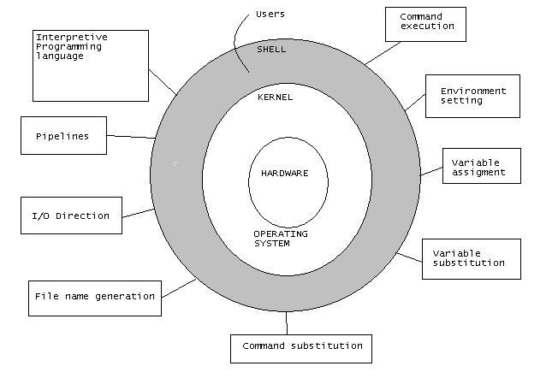
4-1 Shell definition
Notes:
NOTES:

Slide 32
4-2 Shell types
Commonly used shells
/usr/bin/sh POSIX shell
/usr/bin/ksh Korn shell
/usr/old/bin/sh Bourne shell
/usr/bin/csh C shell
/usr/bin/tcsh C shell with auto completion and command line editing
/usr/bin/bash GNU Bourne Again shell
Notes:
NOTES:

Slide 33
4-3 Shell characteristic
Command completion
  <Esc><Esc> or <Tab><Tab>
  Look up commands in $PATH
File name completion
  <Esc><Esc> or <Tab><Tab>
  Look up file name in current working directory
Command combine using pipe (pipelines)
Environment setting
  export name=value
  source command
Notes:
NOTES:

Slide 34
4-4 Shell variables
Assign variables
  name=value
  export name=value
Variables substitution
  name=$name
  Ex: PATH=$PATH:/home/bin
Notes:
NOTES:

Slide 35
4-5 File name generation
?
  Match any single character except a leading dot
*
  Match zero or more characters except a leading dot
Notes:
NOTES:

Slide 36
4-6 Quoting
Single quote ‘
  Single quote hide all special characters from the shell
Double quote “
  Double quotes are used to hide spaces, tab and special characters from the shell
Notes:
NOTES:

Slide 37
4-7 Special characters
Back stick `
  Back sticks are used for command substitution
Back slash \
  Back slash hide the following character from the shell. The character following the back slash loses any special meaning
Semi colon ;
  Semi colon lets you put more than one command on a line
Ampersand &
  Ampersand at the end of a command puts that command into the background
Notes:
NOTES:

Slide 38
4-8 Input output redirection
Standard input - 0
  Keyboard
Standard output - 1
  Monitor
Standard error - 2
  Monitor
Redirection
  command > log
  command > log 2>&1
Notes:
NOTES:

Slide 39
4-9 Regular expression
Star *
  Zero or more times
Dot .
  One or more times
Group []
  [AaBb]
Range –
  [0-9]
  [a-zA-Z]
Slash \
  \*
  \.
Notes:
NOTES:

Slide 40
Process control
5: Process control

Slide 41
5-1 Process basic
PID
  Process ID
PPID
  Parent Process ID
UID
  User to run process
Notes:
NOTES:

Slide 42
5-2 Process context
The text (program instructions) being run
The memory used by the program being run
The current working directory
The files that are open and positions in the files
Resource limits
Access control information
Others—various low-level information
Notes:
NOTES:

Slide 43
5-3 Start process
fork process
  Allocate slot in a process table
  Assign PID to process
  Copy context of the parent
  Return PID to the parent
exec command
  Replace shell command and data with command and data
  run command
Notes:
NOTES:

Slide 44
5-4 Process monitoring
View processes
  ps
  ps -ef
Start process
  Run command
Kill process
  use kill command
Background and foreground process
Notes:
NOTES:

Slide 45
5-5 Job control
job is an executed command line
  use ps command
Job control
  Bring process to background or foreground
  Suspend and resume process execution
Notes:
NOTES:

Slide 46
5-6 Signaling process
Kill command
  kill –s signal pid
Notes:
NOTES:

Slide 47
Shell programming
6: Shell programming

Slide 48
6-1 Variables
Dollars $
  Used to represent shell variable
Variable substitution
  Replace a variable’s name with its value
Process variables
  $? : return value of last command
  $$ : Current process ID
  $- : Contains list of shell options that are turned on
  $! : Process ID of last executed background process
Notes:
NOTES:

Slide 49
6-2 Script execution commands
#!/bin/sh
if, case
for, while, until
Notes:
NOTES:

Slide 50
6-3 Other tools
perl
tcl/expect
python
Notes:
NOTES:

Slide 51
System administration basic
7: System administration basic

Slide 52
7-1 System state - init script
System state
  0 - Shutdown state.
  1 – Single user state
  2 – Multi user state without NFS
  3 – Remote file sharing state
  6 – Reboot state
  4 – Alternate system state (unused)
  5 – X11
Init script
  /etc/inittab
Notes:
NOTES:

Slide 53
7-2 Scheduled tasks
at
  Schedule delayed command
cron
  Run task as schedule
Notes:
NOTES:
A crontab has six fields:
minute (0-59)
hour (0-23)
day of month (1-31)
month of year (1-12)
day of week (0-6, 0 is Sunday)
Command (rest of line)

Slide 54
7-3 Helper tools for redhat
mc
ntsysv
setup
Notes:
NOTES:

Slide 55
GUI basic
8: GUI basic

Slide 56
8-1 X Windows concept
X server
  Provide display capabilities
X Client
  Make a request for displaying on X Server
X protocol
  Protocol between X client and X server
XDMCP
  X Display Manager Protocol
Notes:
NOTES:

Slide 57
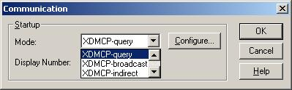
8-2 Settings Display
Install X server
  Exceed
Broadcast mode
Query mode
Indirect mode
Passive mode
  The Passive Startup Mode starts the server without making any initial attempt to connect to a specific host.
Notes:
NOTES:

Slide 58
8-1 Setting gdm (xdm)
/etc/X/gdm/gdm/gdm.conf
  Default configuration is disable broadcast mode
  [xdmcp]
  Enable=false
gdm-restart
Notes:
NOTES:

